Slide 1
Report technical scientific engineering

Slide 2
A scientific report usually consists of the following:
Title
Abstract
Introduction
Materials and methods
Results-graphical data
Discussion
Literature cited

Slide 3
Why was this study performed?
Answers to this question may be derived from observations of nature or from the literature.
What knowledge already exists about this subject?
The answer to this question must review the literature, showing the historical development of an idea and including the confirmations, conflicts, and gaps in existing knowledge.
What is the specific purpose of the study?
The specific hypotheses and experimental design pertinent to investigating the topic should be described.

Slide 4
General Comments on Style
All scientific names (genus and species) must be italicized. (Underlining indicates italics in a typed paper.)
Use the metric system of measurements. Abbreviations of units are used without a following period.
Be aware that the word data is plural while datum is singular. This affects the choice of a correct verb. The word species is used both as a singular and as a plural.
Numbers should be written as numerals when they are greater than ten or when they are associated with measurements; for example, 6 mm or 2 g but two explanations of six factors. When one list includes numbers over and under ten, all numbers in the list may be expressed as numerals; for example, 17 sunfish, 13 bass, and 2 trout. Never start a sentence with numerals. Spell all numbers beginning sentences.
Be sure to divide paragraphs correctly and to use starting and ending sentences that indicate the purpose of the paragraph. A report or a section of a report should not be one long paragraph.

Slide 5
Every sentence must have a subject and a verb.
Avoid using the first person, I or we, in writing. Keep your writing impersonal, in the third person. Instead of saying, "We weighed the frogs and put them in a glass jar," write, "The frogs were weighed and put in a glass jar."
Avoid the use of slang and the overuse of contractions.
Be consistent in the use of tense throughout a paragraph--do not switch between past and present. It is best to use past tense.
Be sure that pronouns refer to antecedents. For example, in the statement, "Sometimes cecropia caterpillars are in cherry trees but they are hard to find," does "they" refer to caterpillars or trees?

Slide 6
Key features of reports
Reports:
• are designed for quick and easy communication of information
• are designed for selective reading
• use sections with numbered headings and subheadings
• use figures and diagrams to convey data

Slide 7
Basic Structure of a Report
A report usually has these components:
Title page
Summary
Table of Contents
Introduction
Middle sections with numbered headings
Conclusions
References
Appendices
References

Slide 8
1. Title page
The title page gives:
• the course name and number, the department and university
• the title of the report
• the authors' names, and ID numbers
• the date of submission
2. Summary
The Summary (~1/2 page) provides a brief overview of the substance of the report.
The summary
• states the topic of the report
• outlines the most important findings of your investigation
• states the key conclusions.
The summary does NOT
• provide general information
• explain why you are carrying out an investigation
• refer to later diagrams or references

Slide 9
Example Summary Summary from a report entitled: Preliminary Design of a Bridge.
Summary
This report presents a design for a bridge to be constructed on the Majuli Freeway crossing in the Brahmaputra Ranges. Two designs for the bridge were devised and then compared by considering the cost, construction and maintenance of each bridge. Design 1 is a super-T beam bridge while Design 2 is a simple composite I girder bridge. It is concluded that Design 1 is the better design. This design is cheaper, easier to construct, more durable and easier to maintain.

Slide 10
Table of Contents
The table of contents sets out the sections and subsections and their corresponding page numbers.
• Number the sections by the decimal point numbering system:
1.0 Title of first main section (usually Introduction)
1.1 First subheading
1.2 Second subheading
2.0 Title of second main section
2.1 First subheading
2.2 Second subheading
2.2.1 First division in the second subheading
2.2.2 Second division in the second subheading

Slide 11
Number all the preliminary pages in lower-case Roman numerals (i,ii,iii,iv,…).
You don't have to place the number i on the title page. Just count it and put ii on the second page of your report.
• Number all the remaining pages of your report with numerals (1,2,3,4,…). Thus your report begins on page 1 with your Introduction.
• Provide a title in your table of contents to describe the contents of each appendix
(Note: one Appendix, two or more Appendices). Don’t just call them Appendix 1 or Appendix 2.
For example: Appendix 1: Sample Calculations.

Slide 12
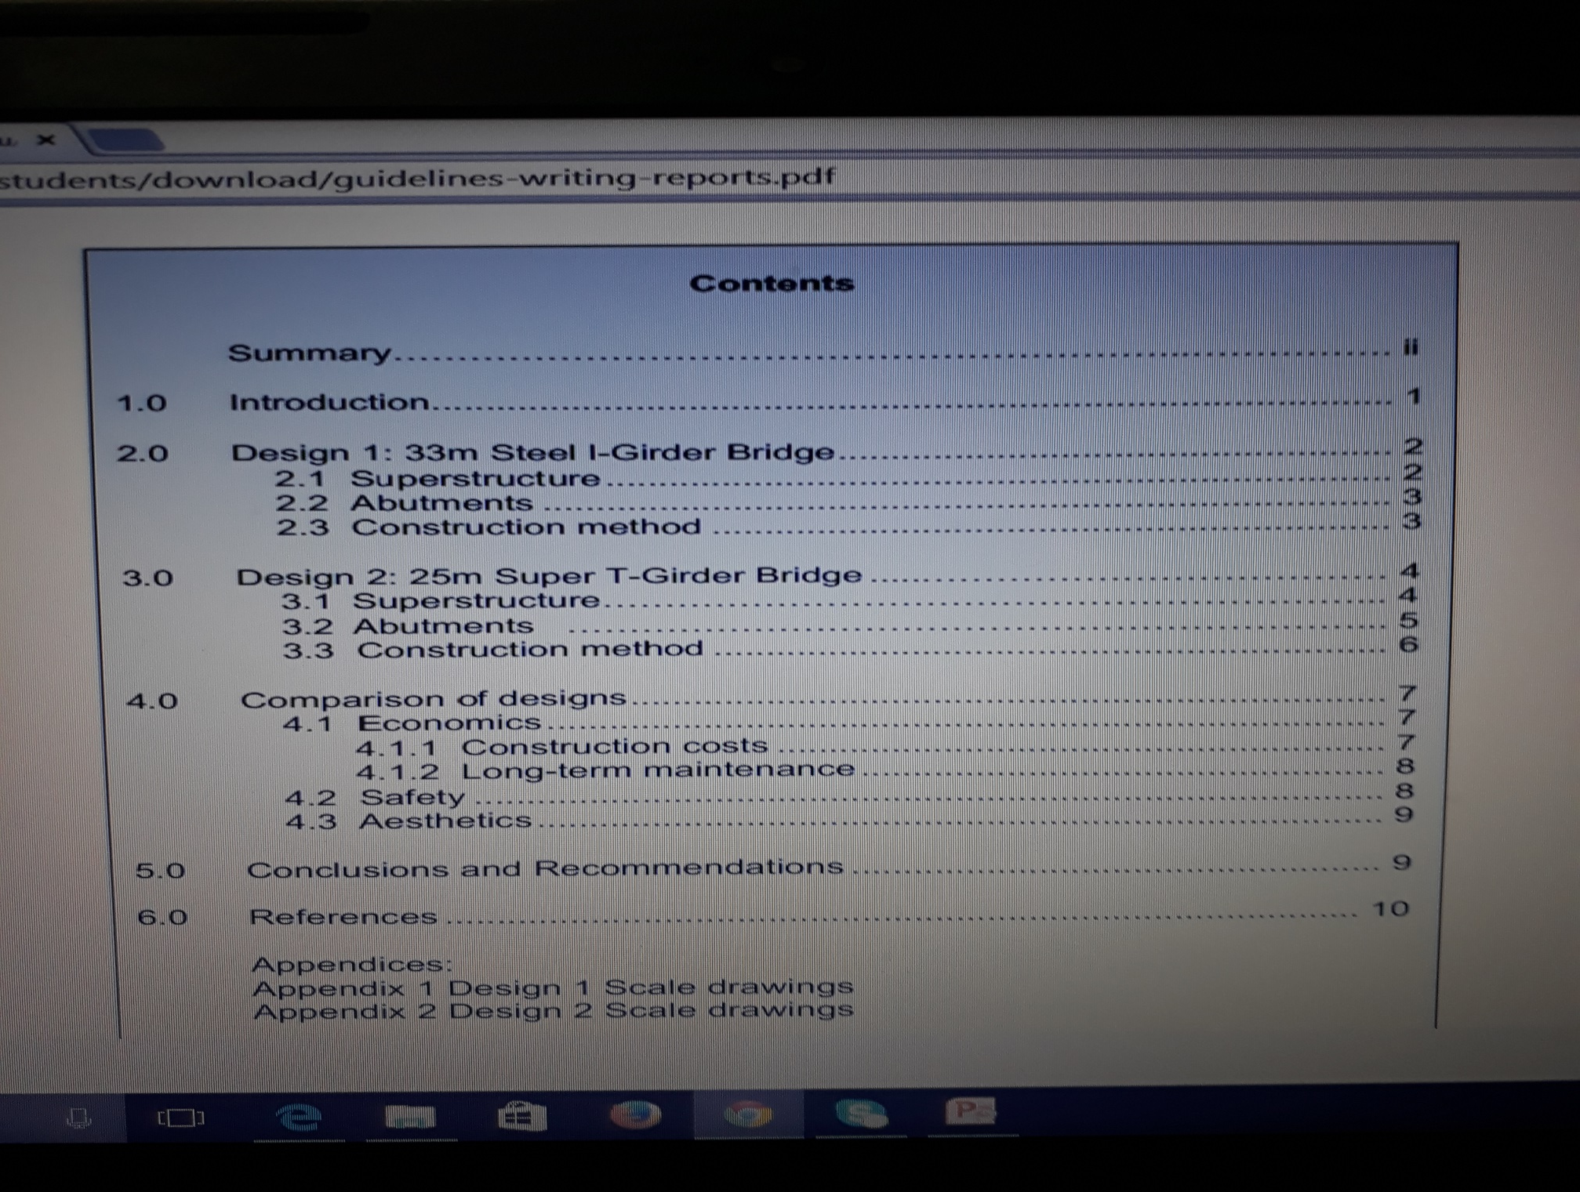

Slide 13
The introduction (~1/2-3/4 page ) provides the background information needed for the rest of your report to be understood. It includes:
• a clear statement of the purpose of the investigation
• the background of the topic of your report
• a brief outline of the structure of the report if appropriate (this would not be necessary in a short report) .

Slide 14
Body of the report
The body of the report presents the information from your research, both real world and theoretical organises information logically under appropriate headings conveys information in the most effective way for communication:
− uses figures and tables
− can use bulleted or numbered lists
− can use formatting to break up large slabs of text.

Slide 15
Incorporating figures and tables:
Refer to each figure and table in the text of the report.
Example: The communication channels in the organization are shown in Diagram 1.
Give all figures a title.
Example: Table 1 Existing communication channels .The title of a table goes above the table while the title of a figure goes below the figure.
• Figures must be correctly referenced if necessary. Give the source of the diagram or the data if you have taken them from published sources.

Slide 16
Incorporating equations:
You will often have to include equations in your reports. The conventional style for presenting equations is as follows.
1. Centre the equation on the page.
2. Place the equation number in round brackets at the right-hand margin.
3. In the text of your report, refer to the equation as either Eq. (1) or equation (1).
Use whichever format you choose consistently throughout your report.

Slide 17
Example:
The relationship of the speed of propagation and the volumetric tissue fraction is given by:
v = 1 (1)
√ ((1 – h) Kf
-1 + h Kt
-1 ) ((1- h) ρf + h ρt )
We can see from Eq. (1) that ……

Slide 18
Conclusion
The Conclusion (~1-2 paragraphs) relates directly back to the aims of the investigation. The Conclusions section provides an effective ending to your report.
This section states whether you have achieved the aims of your investigation gives a brief summary of the key information in your report restates the major findings of your investigation.

Slide 19
References
The two parts to referencing are:
1. citations in the text of the report
2. a list of references in the final section.
Citations show that information comes from another source.
The list of references gives the details of these sources.

Slide 20
You need to use citations in your writing when:
• you incorporate information from other sources:
− factual material
− graphs and tables of data
− pictures and diagrams
• you quote word-for-word from another work.
For example, in a lab report when you present the theory in the Introduction you must include citations which provide the source of this theory.

Slide 21
Bibliography
A bibliography is a list of all the sources that you have consulted while
writing your report, only some of which are cited in the text, so it provides a
wider list of readings than you give in your list of references.
In Engineering reports, you always have to provide a list of references in the
References section. Only occasionally you may also be asked to provide a bibliography.
8. Appendices
• These contain material that is too detailed to include in the main report.
• Each appendix must be referred to at the relevant point in the text.
Example:
The data obtained are summarised below. The detailed data are given in
Appendix 3.

Slide 22
Activities
Write a report on your area of interest /domain/or your future projects keeping in mind the style and structure of the report and submit on …………………

Slide 23
activities
Acid rain
Global warming
Solar energy devices
Bomb detection methods
Nuclear fusion
Big Bang Theory
Black widow spiders
Migraines
Ozone depletion

Slide 24
Recycling
Dyslexia
effects of nicotine
high-tech weaponry
solar automobiles
thermal power
nuclear fusion
Life on Mars

Slide 25
The Global Benefits of Eating Less Meat (from Compassion in World Farming Trust)
The Right to equity: gender and diversity
(from Oxfam UK)
Report on health and hygiene
Report on construction of road/DAMS/bridge/subway/flyover(progress report)
Report on finance

Slide 26
Report on election campaigning
Report on crime rate in your State
Report on teacher effectiveness in teaching PHY/MATH/ENG/CORE SUBJECTS/CHEMISTRY/ENGG SUBJECTS

